Slide 1

React
Form & Lifting State

Slide 2
# Table of Contents
Forms
Lifting State
Conditional Rendering
Composition

Slide 3
Forms

Slide 4
# Forms
React form is different than HTML form (handling).
Controlled component: Component yang dikontrol oleh React.
Controlled component: input, select, textarea
Using state to control form
Referensi: React- Forms.

Slide 5
# Form Event
onSubmit: Ketika component di-submit (form).
onChange: Ketika nilai component berubah (input, select, textarea).
Referensi: React- Forms.

Slide 6
# Handle Title
Menghandle ketika nilai input (title) berubah.
Menggunakan event onChange.
Menggunakan state untuk menyimpan value.
Referensi: React- Forms.

Slide 7
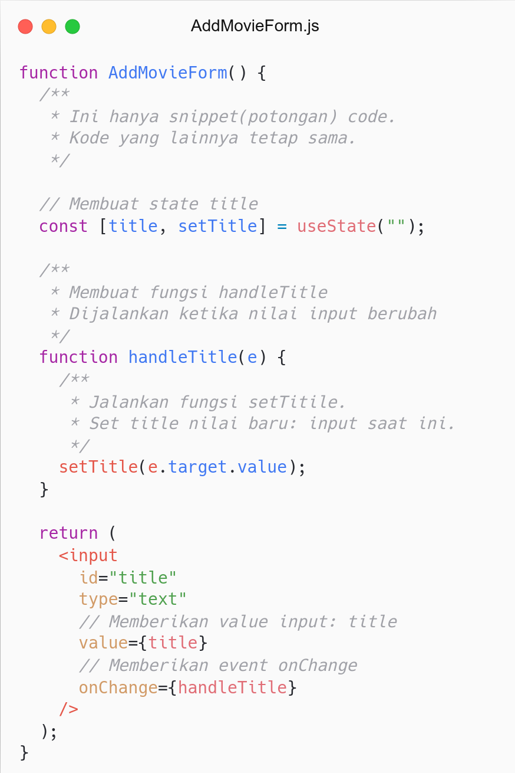
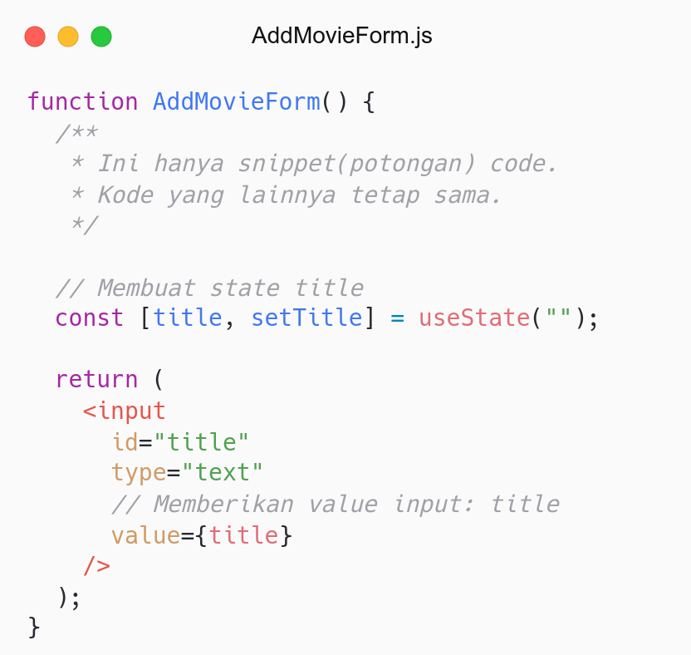

Slide 8
# Handle Date
Menghandle ketika nilai input (date) berubah.
Menggunakan event onChange.
Menggunakan state untuk menyimpan value.
Referensi: React- Forms.

Slide 9
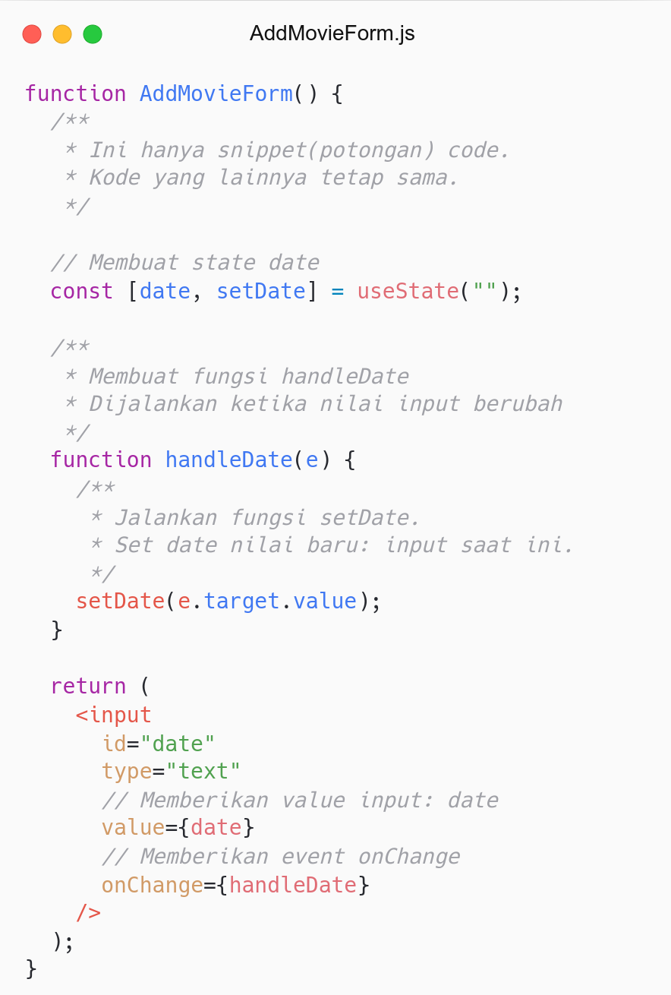
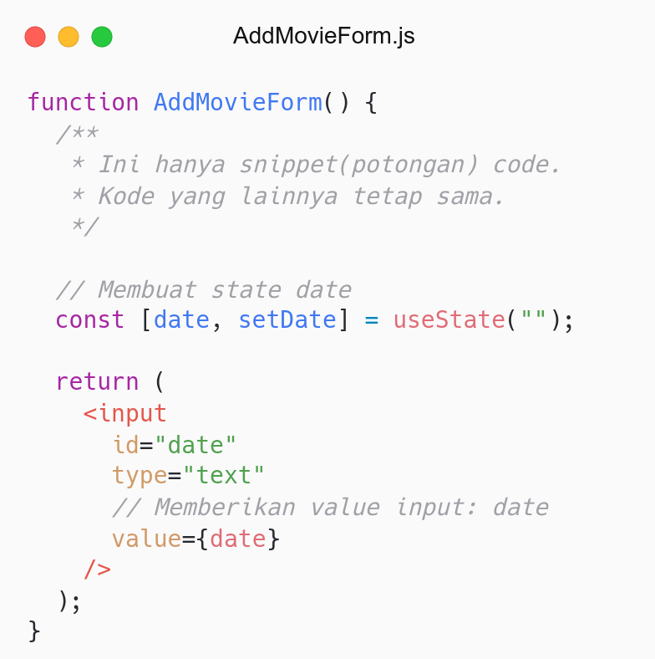

Slide 10
# Handle Submit
Menghandle ketika form di-submit.
Menggunakan event onSubmit.
Referensi: React- Forms.

Slide 11
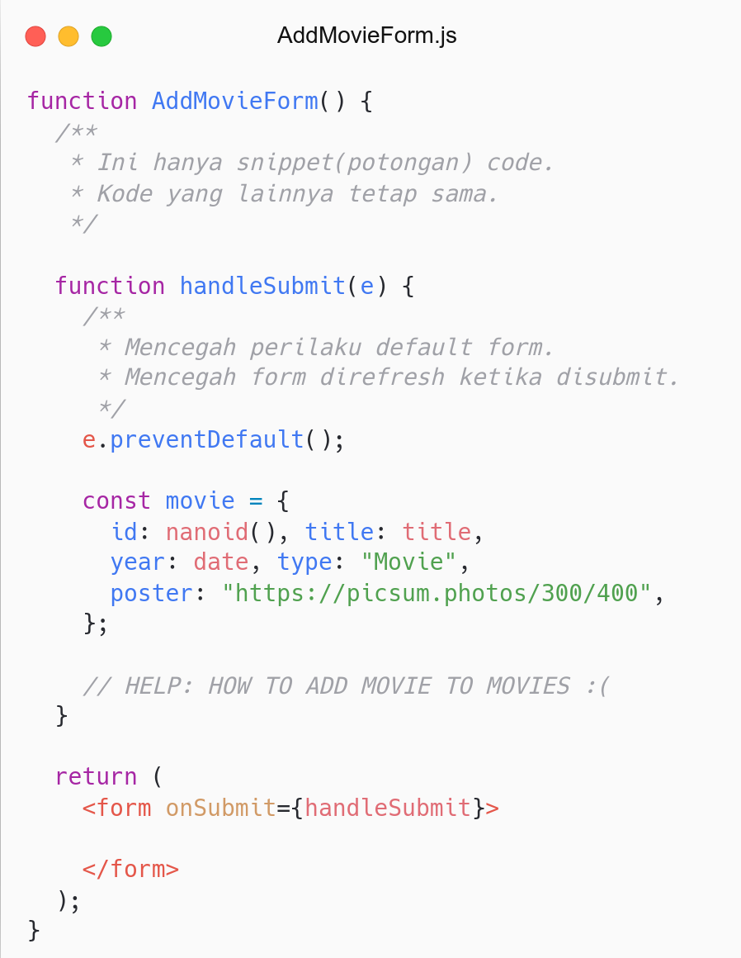
HELP :(
How to add movie to state movies?
What is solution?

Slide 12


How to add movie to state movies?
Component
State
Data Movie

Slide 13
Lifting State

Slide 14
# Lifting State
Several components need the same state.
Lifting state to their closest parent component.
Referensi: React- Lifting State.

Slide 15
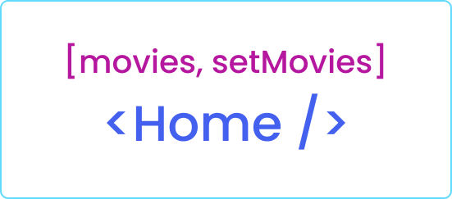
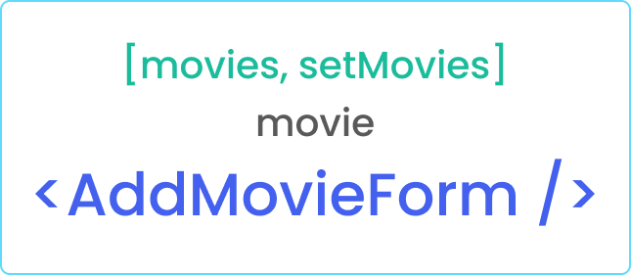
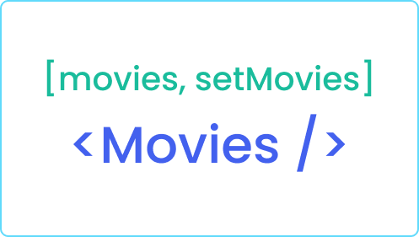
Lifting State
Component
State
Props
Data Movie

Slide 16
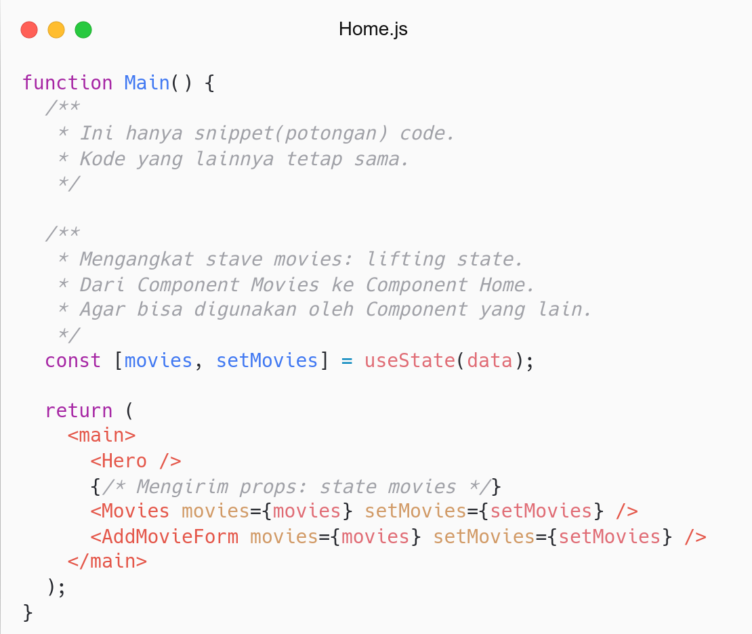

Slide 17
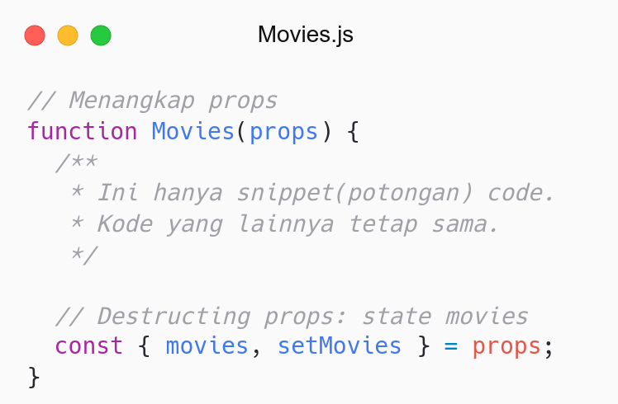

Slide 18
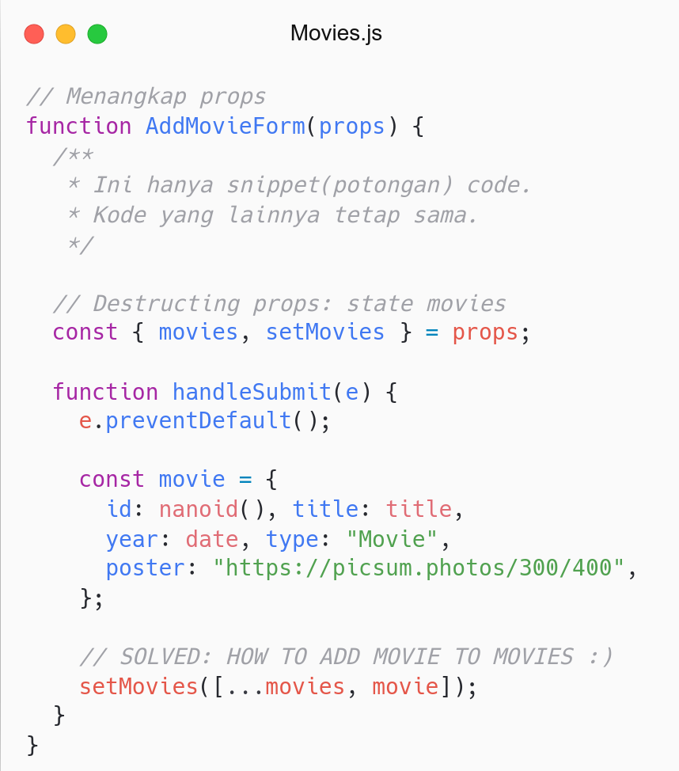

Slide 19
Conditional Rendering

Slide 20
# Conditional Rendering
Render Component based on condition (state).
Conditional in React is similar to JavaScript.
Type:
Conditional: If, Else If, Else
Inline If: Operator &&.
Inline If-Else: Conditional Operator.
Referensi: React- Conditional Rendering.

Slide 21
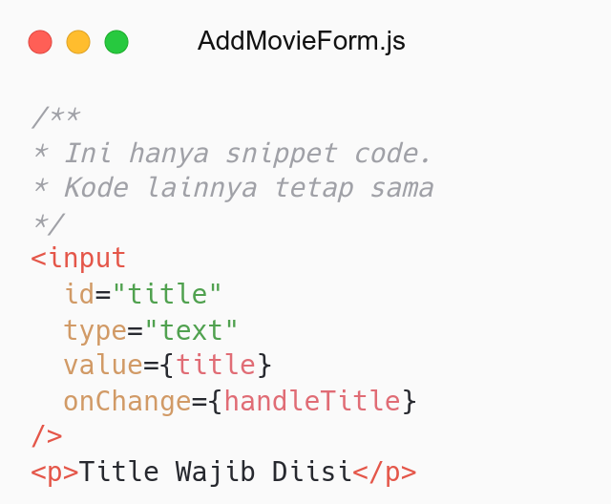
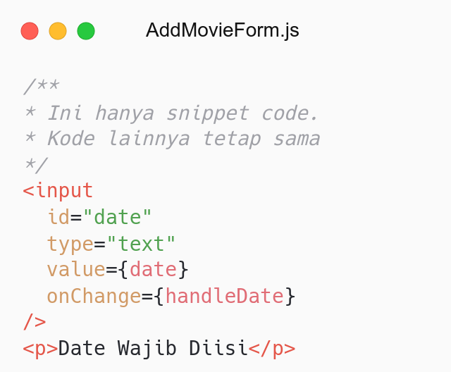
How to show error if form is empty?

Slide 22
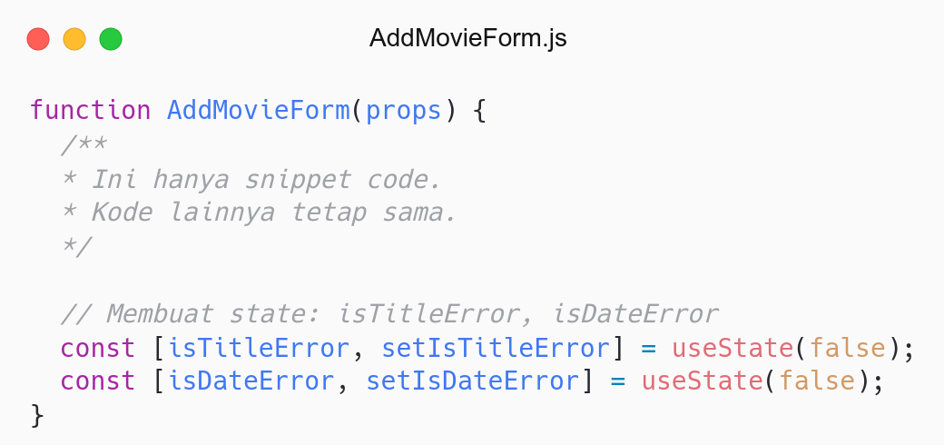

Slide 23
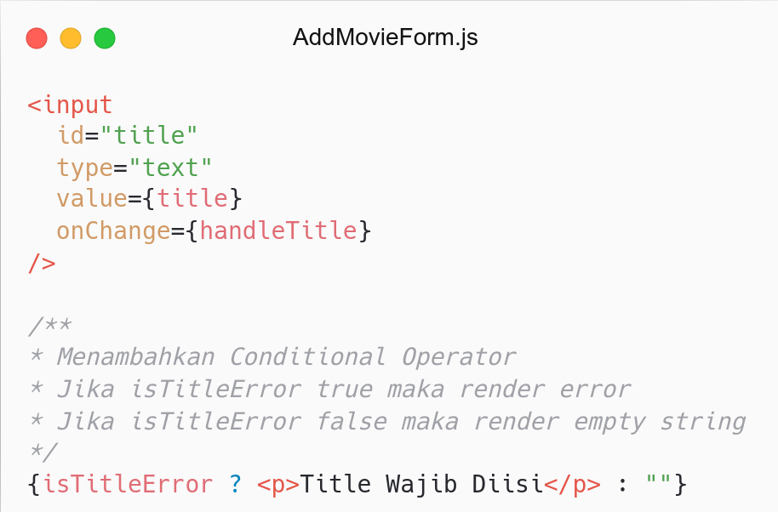
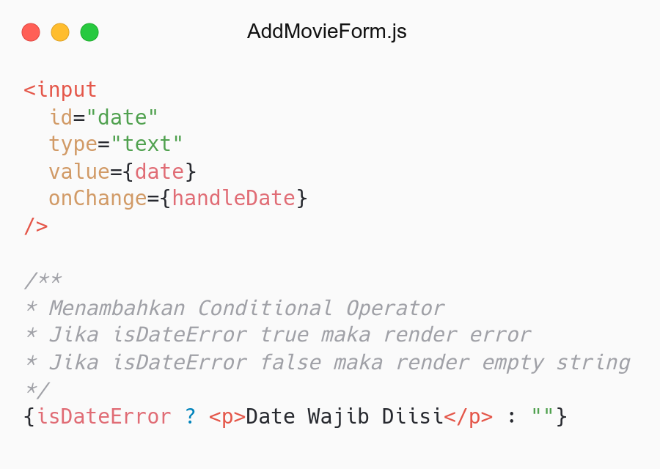

Slide 24
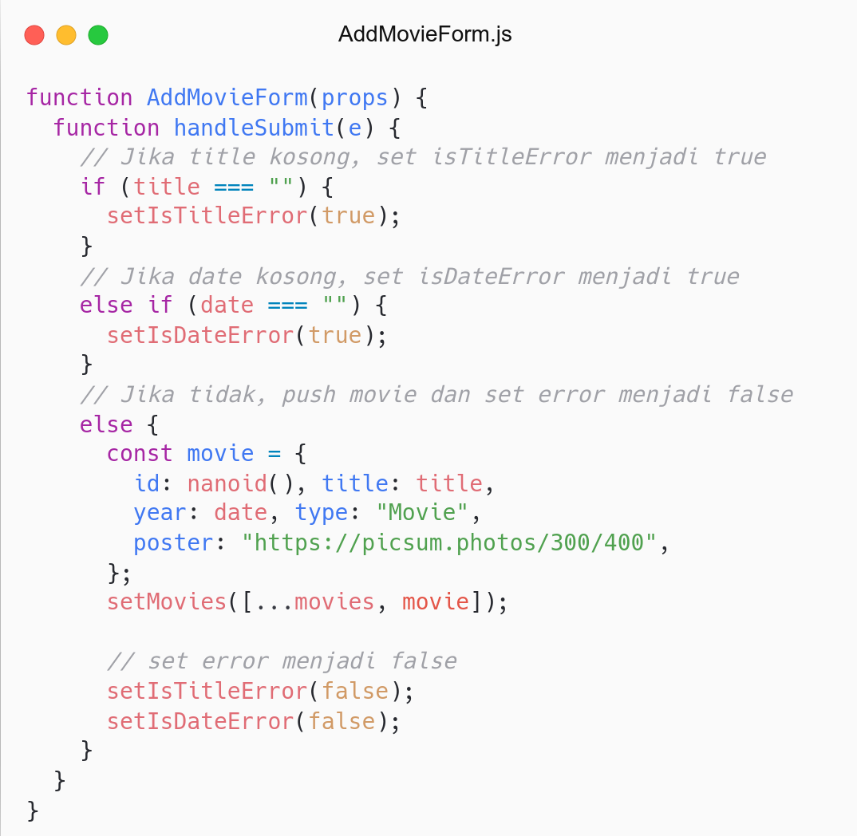

Slide 25
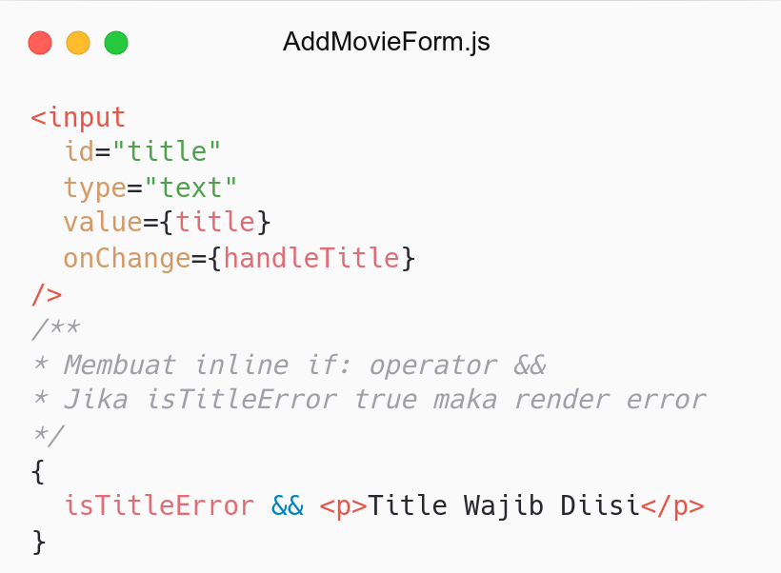
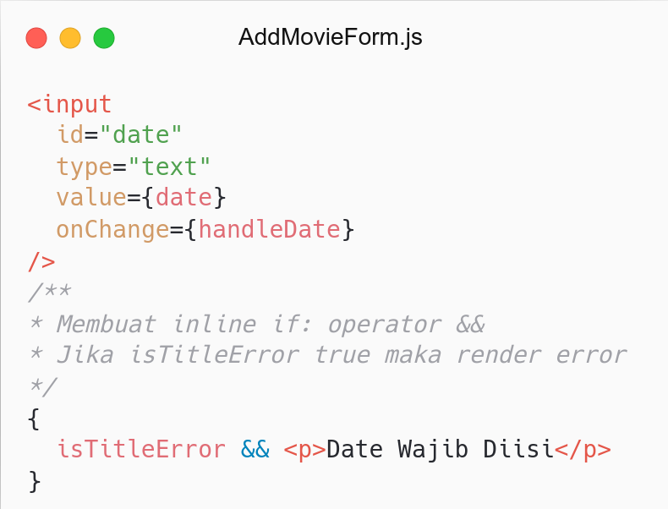

Slide 26
Composition

Slide 27
# Composition
Reuse code between components
React has a powerful composition model
Type:
Containment: Send children (prop) to component.
Specialization: Component be “special cases” of other components.
Referensi: React- Composition.

Slide 28
# Containment
Some components don’t know their children.
Use special children prop to pass children into component.
Referensi: React- Composition.

Slide 29
Why don’t create Error Component?
and send children as props?

Slide 30
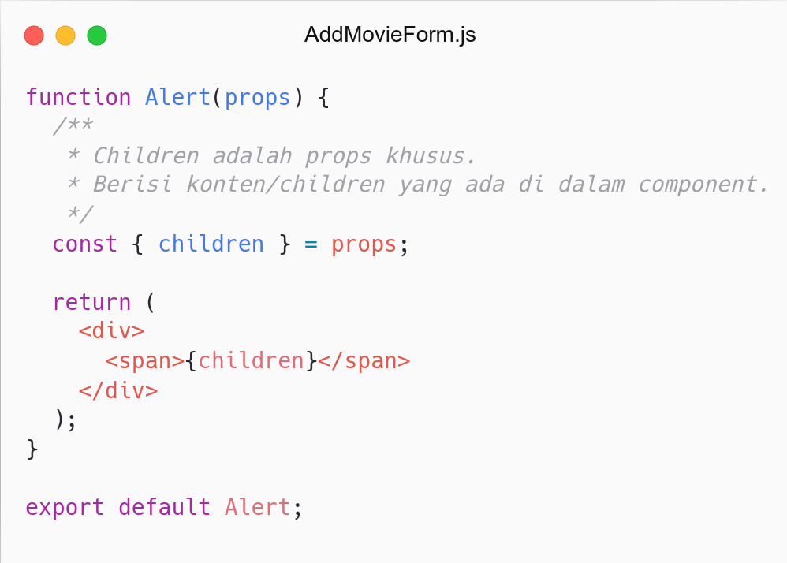
Composition
Send children as props (Containment)

Slide 31
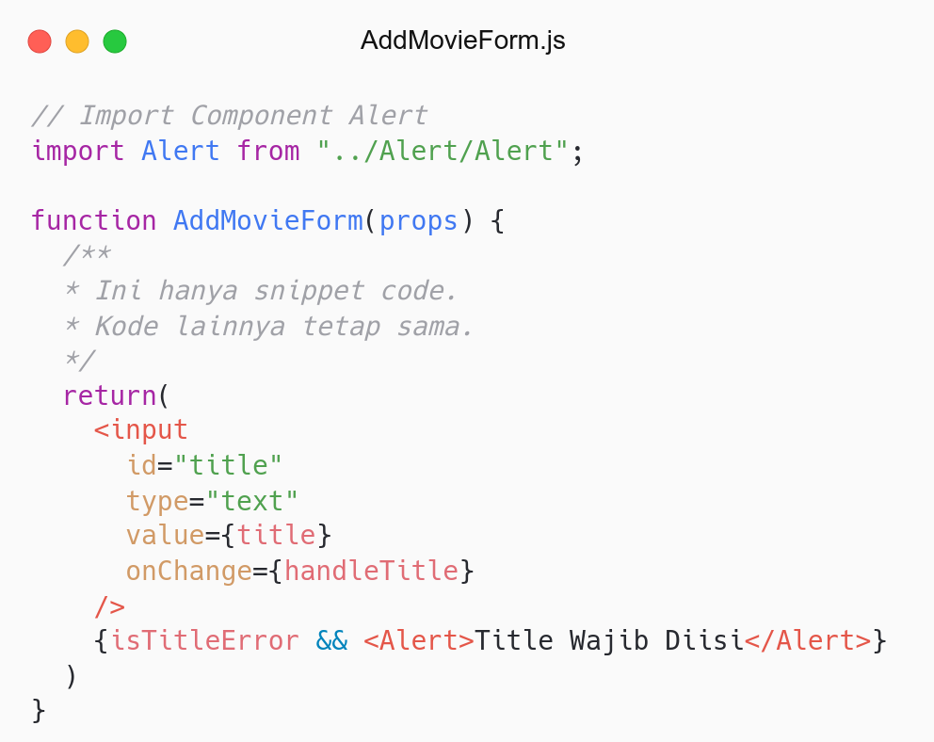
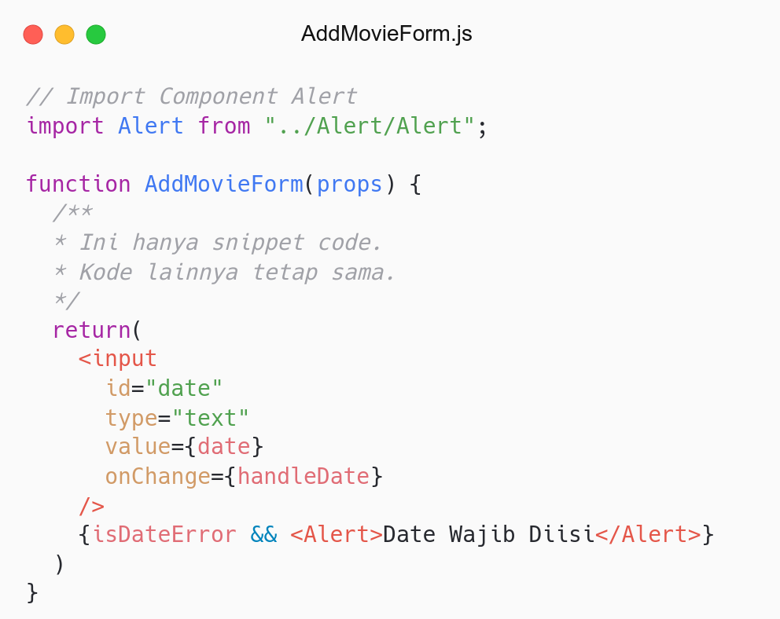

Slide 32
# Recap
JSX: Menulis UI (HTML) di React.
Component: Reusable UI, tersusun oleh element(s).
Props: Input pada Component.
State: Private Data pada Component.
List and Keys: Render multiple Components.
Event: Action yang terjadi pada Component.
Forms: Handle form
Lifting State: Mengangkat state (shareable).
Conditional Rendering: Render component berdasarkan kondisi (state).
Composition: Menyusun component agar dapat digunakan kembali.

Slide 33
Refactor

Slide 34
# Refactor
Forms: Handle multiple input.
Forms: Handle multiple input and validation.
Navbar: Toggle Navbar.

Slide 35
QnA

Slide 36
Take Away

Slide 37
# TODO
Buat tag input untuk memasukkan link gambar.
Buat tag select dan option untuk memilih type movie: Action, Drama, Horror, Comedy, dll.
Handle tag input dan select menggunakan state.
Pastikan movie baru muncul sesuai dengan data yang diinput di form.
Hint:
Handle select: React - Form.

Slide 38
# Assignment
Push code to Repository Github (use branch for task management).
No zip and don’t push node_nodules folder.
Submit link repository to elena.
Kamis: 31 Maret 2022, Link Elena.
Jumat: 01 April 2022, Link Elena.

Slide 39
Attendance

Slide 40
Thanks

